Slide 1
How to listen to your children
https://github.com/skeletonkey/PerlMongersConcurrence

Slide 2
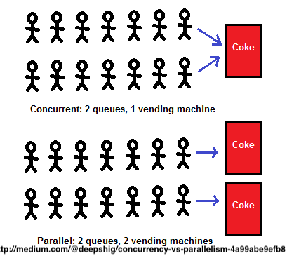
Concurrency vs Parallelism
“Concurrency is about dealing with lots of things at once. Parallelism is about doing lots of things at once.” – Golang Blog

Slide 3
Concurrency ~ logical blocks
Can have independent start/stop times
Can be run in parallel

Slide 4
The problem ….
Health of a system: http://127.0.0.1:5000/healthcheck
But … you have 100 instances?
Also … It’s a heavy healthcheck

Slide 5
Answer:
A Dashboard!!!!!

Slide 6
1st Approach
Write a script!
Up to 10 seconds per healthcheck???
Ok while your small

Slide 7
Fork to the rescue
“create a new process running the same program at the same point.” – perldoc –f fork
Caveats:
Whole program is duplicated
Straying into the realm of platform specific
Responsibilities (no child neglect!)

Slide 8
Why not Thread
Cause I just don’t know that much about it :P
Not ready for prime time?

Slide 9
open() to the rescue
Sort of ... (fork in disquise)
“File descriptors (and sometimes locks on those descriptors) are shared, while everything else is copied.” – perldoc –f fork
man perlipc (Using open() for IPC)
man perlopentut
my $child_pid = open my $fh, "-|";

Slide 10
Limitations
Short running processes
One way communication

Slide 11
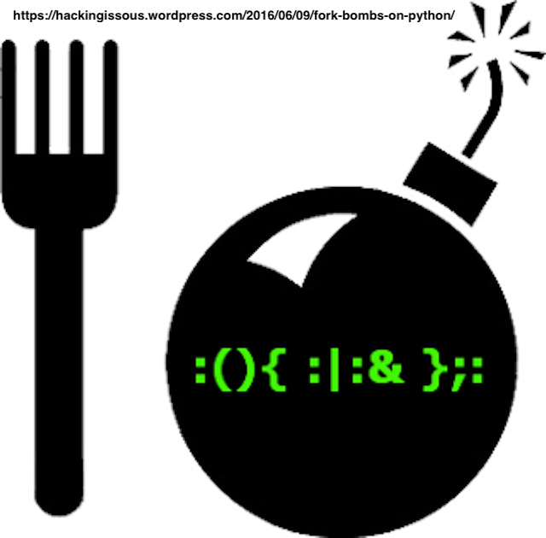
Too many children….
Fork bombing

Slide 12
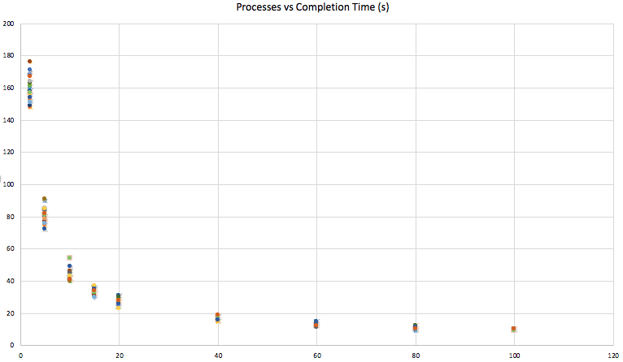
Performance

Slide 13
Resources
https://metacpan.org/search?q=parallel
man pages: perlopentut, perlipc
perl –f: fork, open
https://medium.com/@deepshig/concurrency-vs-parallelism-4a99abe9efb8
https://blog.golang.org/concurrency-is-not-parallelism

